Slide 1
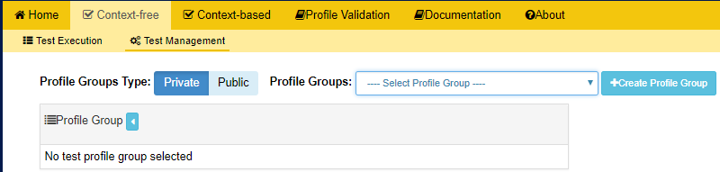
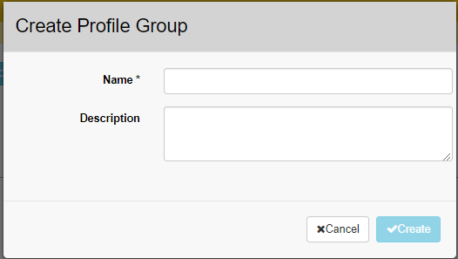
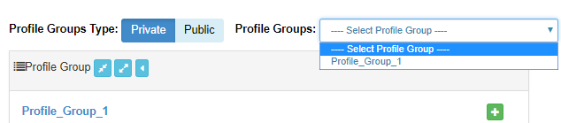
Context-Free Test Management: Creating Profile Groups
Click on Test Management on the Context-free validation tab.
Click on +Create Profile Group.
2
1
Enter the Profile Group Information.
3
The Profile Group is created and added to the Private Profile Groups Type panel by default and to the Select Profile Group drop down menu.
Click + to add profiles under the selected Profile Group.
4
5

